Slide 1
Technical English - Nomenclature

Slide 2
1.) Inorganic chemistry
Philosophy:
-Read the formula from left to right
-Express the oxidation state in terms of the number of anions (binary compounds) or a suitable prefix/suffix corresponding to a very low/lower/higher/very high oxidation number (oxyacids and their salts)
-Need to know all the common oxidation numbers of elements!

Slide 3
a) Binary compounds
Kladné oxidačné číslo vyjadrené počtom aniónov. Ak daný prvok nemá známe iné kladné ox. č., počet aniónov sa v názve nevyjadruje.
Predpony pre počet: mono, di, tri, tetra, penta, hexa, hepta...
MgCl₂
Slovenčina: sprava doľava - chlorid horečnatý
Angličtina: zľava doprava - magnesium chloride (Mg nemá iné ox. č.)
FeCl₂
Slovenčina: koncovka – chlorid železnatý
Angličtina: počet aniónov – iron dichloride (Fe môže mať aj ox. č. +III)

Slide 4
a) Binary compounds
Try it yourself ☺
Li₃N – lithium nitride
BeS – beryllium sulfide
Al(OH)₃ – aluminium hydroxide
SO₂ – sulphur dioxide
OsO₄ – osmium tetroxide (tetra shortened to “tetr” for easier pronunciation)

Slide 5
b) Hydracids
Hydro…-ic acid ak ide o vodný roztok:
HF hydrofluoric acid
HCl hydrochloric acid
HBr hydrobromic acid
H₂S hydrosulfuric acid
V opačnom prípade uplatňujeme názvoslovie binárnych zlúčenín, napr. hydrogen fluoride.

Slide 6
c) Oxyacids
We use a system of prefixes and suffixes.
If the given element can have 4 different oxidation numbers:
HClO hypochlorous acid hypo + -ous
HClO₂ chlorous acid -ous
HClO₃ chloric acid -ic
HClO₄ perchloric acid per + -ic
Periodic table!

Slide 7
c) Oxyacids
If the given element can have 3 different ox. no.:
H₃PO₂ hypophosphorous acid hypo + -ous
H₃PO₃ phosphorous acid -ous
H₃PO₄ phosphoric acid -ic

Slide 8
c) Oxyacids
If the given element can have 2 different ox. no.:
HNO₂ nitrous acid -ous
HNO₃ nitric acid -ic
If the given element can have only one oxidation number:
H₂CO₃ carbonic acid -ic

Slide 9
c) Oxyacids
Try it yourself:
HBrO₃ – bromic acid
H₂SO₃ – sulfurous acid
HIO – hypoiodous acid

Slide 10
d) Salts of oxyacids
Change in the suffix:
-ous to -ite
-ic to -ate
ClO⁻ is hypochlorite
SO₄²⁻ is sulfate
BrO₄⁻ is perbromate

Slide 11
d) Salts of oxyacids
Try it yourself:
CaSO₄ – calcium sulfate
NaClO₂ – sodium chlorite
KMnO₄ – potassium permanganate

Slide 12
Alternative nomenclature for binary ionic compounds
1.) Use the suffix -ous/-ic in the Latin name of the metal:
CuCl is cuprous chloride
CuCl₂ is cupric chloride
FeO is ferrous oxide
Fe₂O₃ is ferric oxide
PbO is plumbous oxide
PbO₂ is plumbic oxide

Slide 13
Alternative nomenclature for binary ionic compounds
2.) Write the oxidation number in Roman numerals in brackets:
CuCl is copper(I) chloride
CuCl₂ is copper(II) chloride
FeO is iron(II) oxide
Fe₂O₃ is iron(III) oxide
PbO is lead(II) oxide
PbO₂ is lead(IV) oxide
In spoken language, the ox. no. is pronounced, e.g. "copper one chloride".

Slide 14
2.) Organic chemistry
Philosophy:
- Identify the longest carbon chain or cycle
- The suffix will be the highest ranked functional group from the priority list
-Prefixes will be all the other groups
-Express the number of identical groups by a prefix (di, tri…)
The English system is virtually identical to the Slovak one! The only difference is in pronunciation and word count.

Slide 15
a) Alkanes, alkenes, alkynes
Alkán je alkane
methane, ethane, propane, butane, pentane…
Alkén je alkene
ethene, propene…
Alkín je alkyne
ethyne, propyne, but-1 or 2-yne...

Slide 16
b) Cyclic and aromatic hydrocarbons
cyklo je cyclo
benzén je benzene
fenol je phenol
Complicated, isn‘t it?

Slide 17
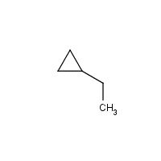
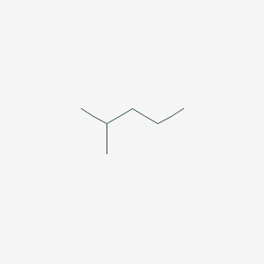
Organic chemistry
Try it yourself:

Slide 18
Organic chemistry
Try it yourself
ethylcyclopropane cyclopenta-1,3-diene
2-methylpentane buta-1,3-diene cyclohexane

Slide 19
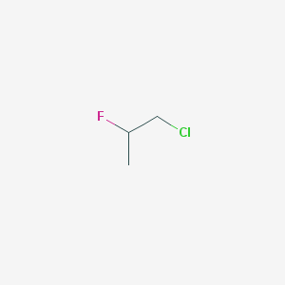
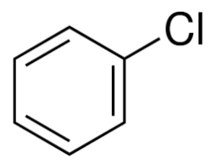
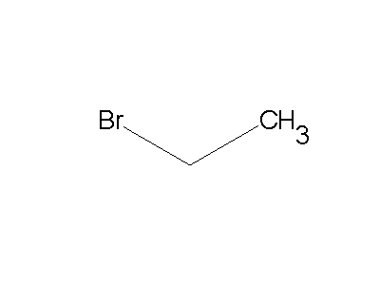
c) Halogen derivatives
CHCl₃
Careful with the aplhabet!

Slide 20
c) Halogen derivatives
trichloromethane chlorobenzene 1-chloro-2-fluoropropane
bromoethane 1,1,1,2-tetrafluoroethane

Slide 21
d) Functional groups based on O, N and S
R-OH (alcohol) R-O-R (ether) RHC=O (aldehyde) RCH₂-CO-CH₂R (ketone) RCOOH (carboxylic acid) RCOOR (ester) (RCO)₂O (acid anhydride) RCOCl (acyl chloride) | RCONH₂ (amide) R-NH₂ (amine) R-CN (nitrile) R-SH (thiol) R-S-R (sulfide) RSOR (sulfoxide) RSO₂R (sulfone) RSO₃H (sulfonic acid)

Slide 22
Organic chemistry
Try:
2-aminoethanoic acid
chloromethyl ethyl ether
4-bromopent-2-ene

Slide 23
Organic chemistry
Try:
2-aminoethanoic acid
chloromethyl ethyl ether
4-bromopent-2-ene

